Slide 1

Proposed Solution to deploy pipelines for applications and infrastructures in Blue Harvest
Promise Uche Nwachukwu

Slide 2


Agenda
Description of Infrastructure
Orchestration Technology
Automation of Infrastructure Deployment
Automation of Application Deployment
Testing approach for Infrastructure
Monitoring approach for Solution

Slide 3

Introduction
This short presentation describes my proposed solution to Blue Harvest.

Slide 4



Description of Infrastructure

Slide 5
Description of Infrastructure
The best infrastructure to use for this scenario would be a kubernetes cluster deployed in the cloud which will help to ensure easy autoscaling of the infrastructure and the applications deployed in it.

Slide 6
Orchestration Technology

Slide 7
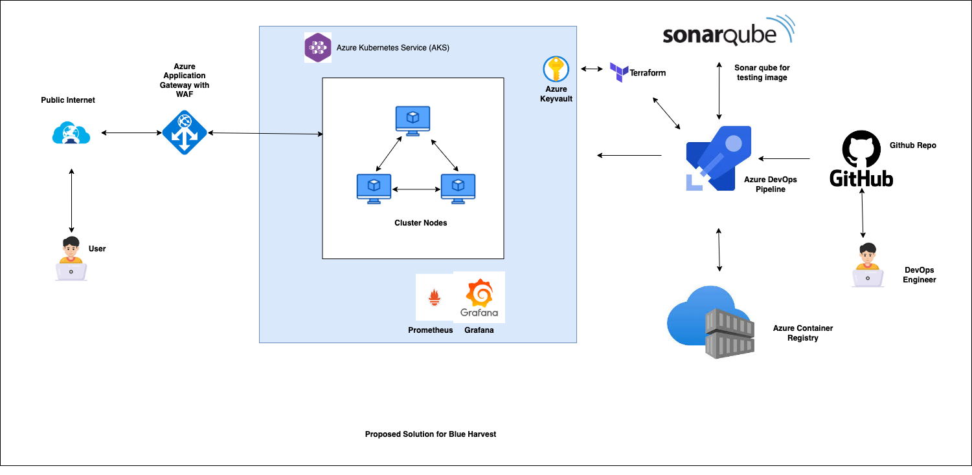
Architectural Diagram

Slide 8
Orchestration Technology Components
Kubernetes Cluster
Terraform
Application Gateway
Container Registry
Grafana
Prometheus
CI/CD Azure Pipeline
Keyvault
GitHub (Version Control)
Sonar Qube (For Testing)

Slide 9
Automation of Infrastructure Deployment

Slide 10
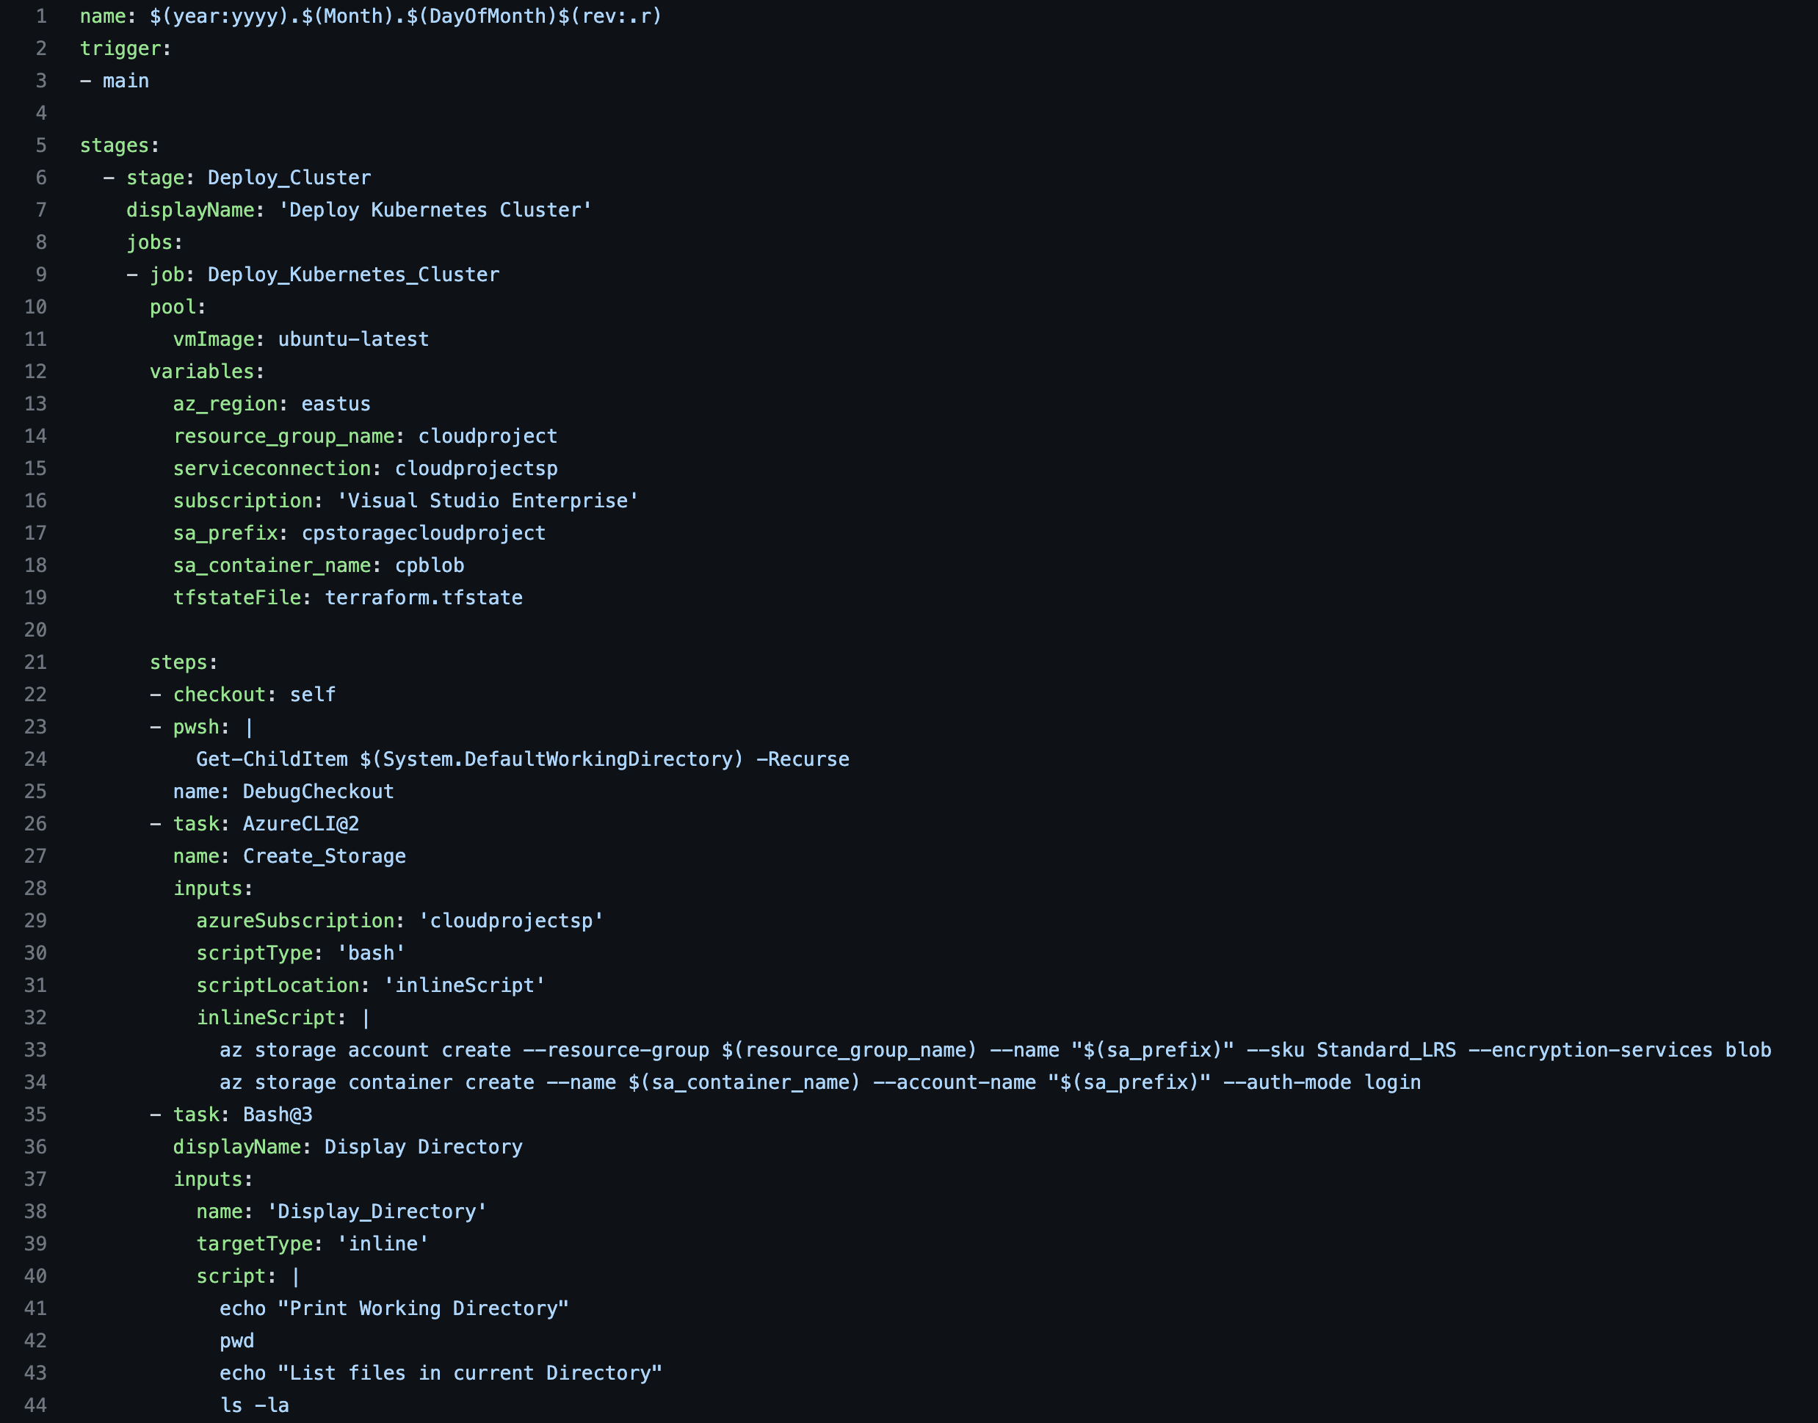
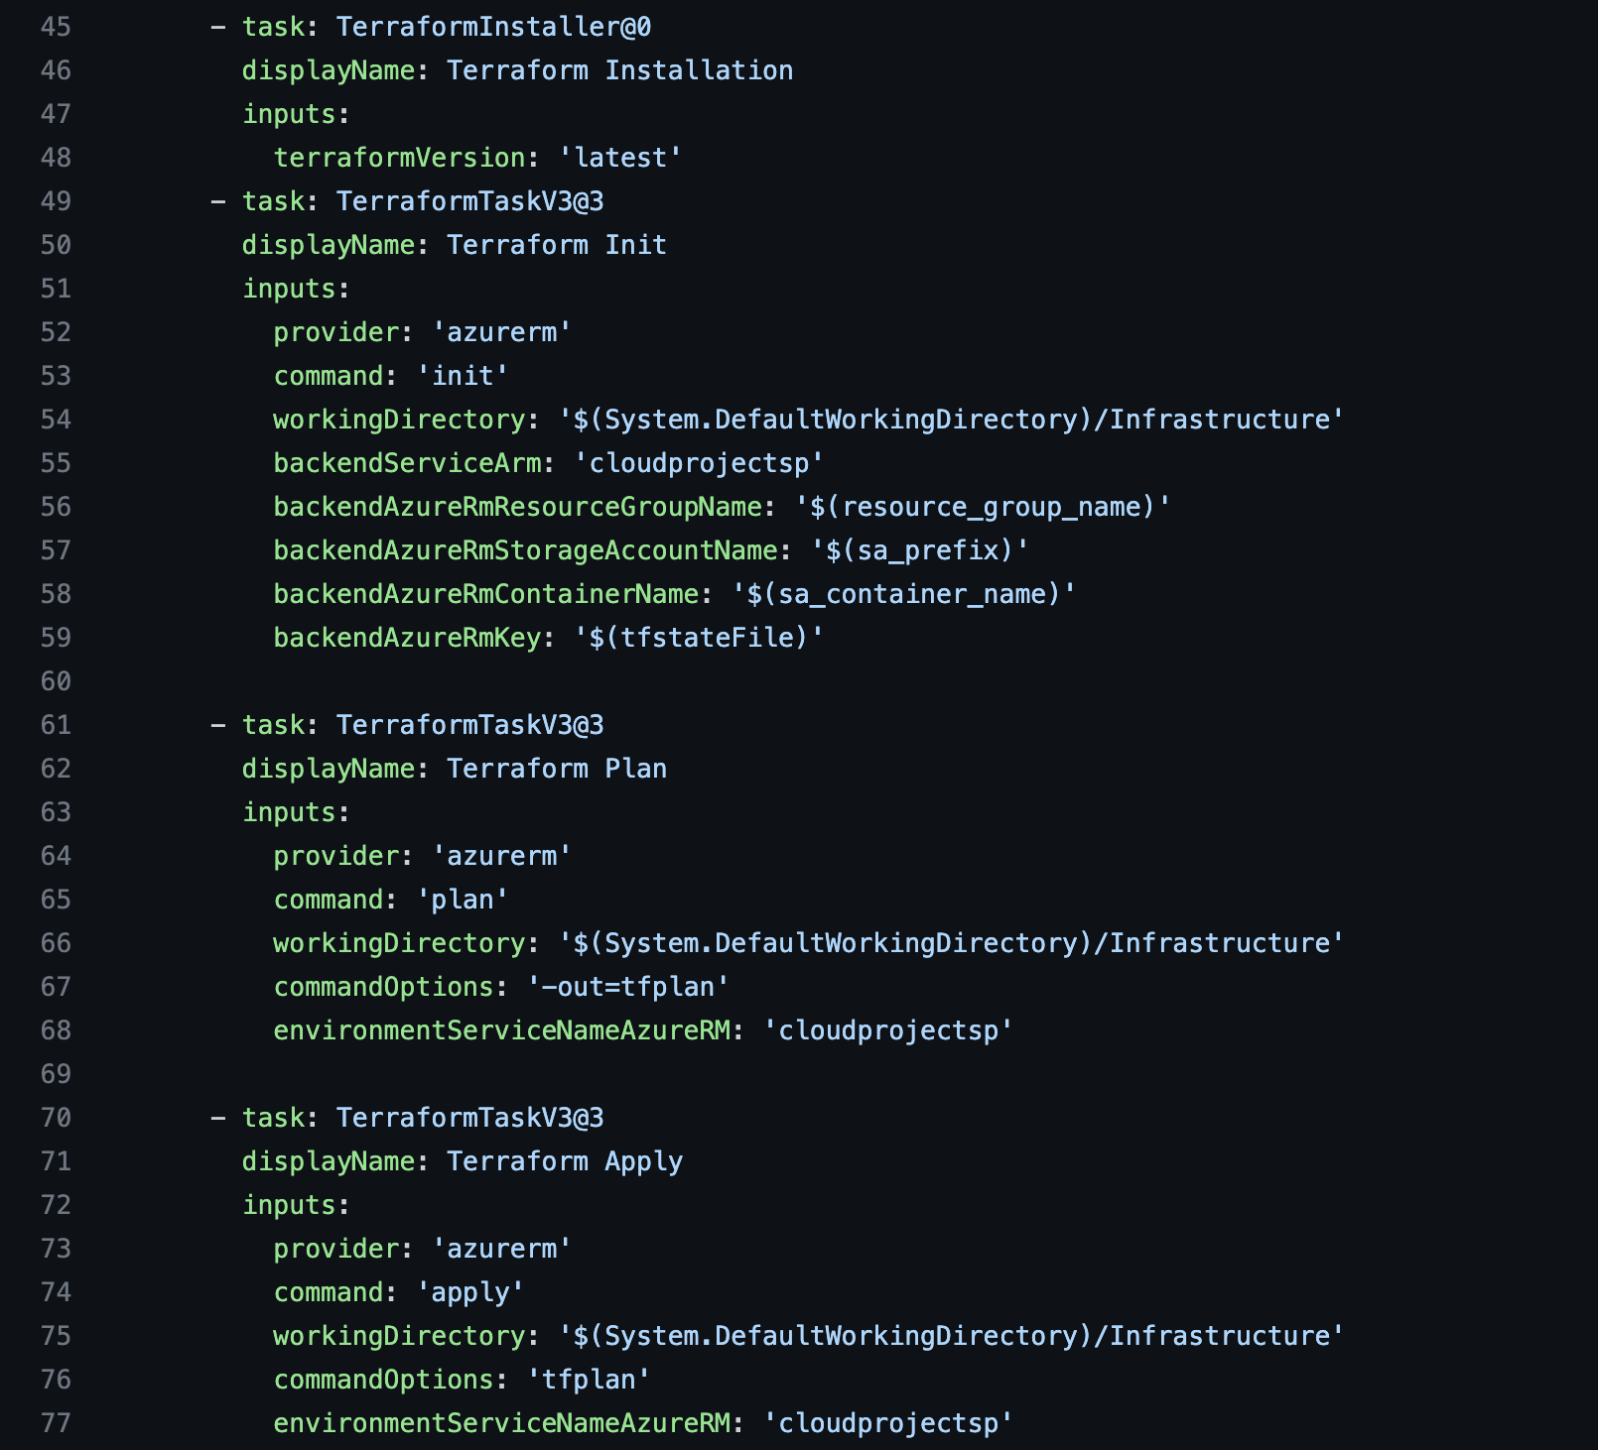
Infrastructure Pipeline Configuration File
Repository Link: https://github.com/promiseuche/cloud-project/blob/main/Infrastructure/kubernetes-cluster-deployment.yml

Slide 11
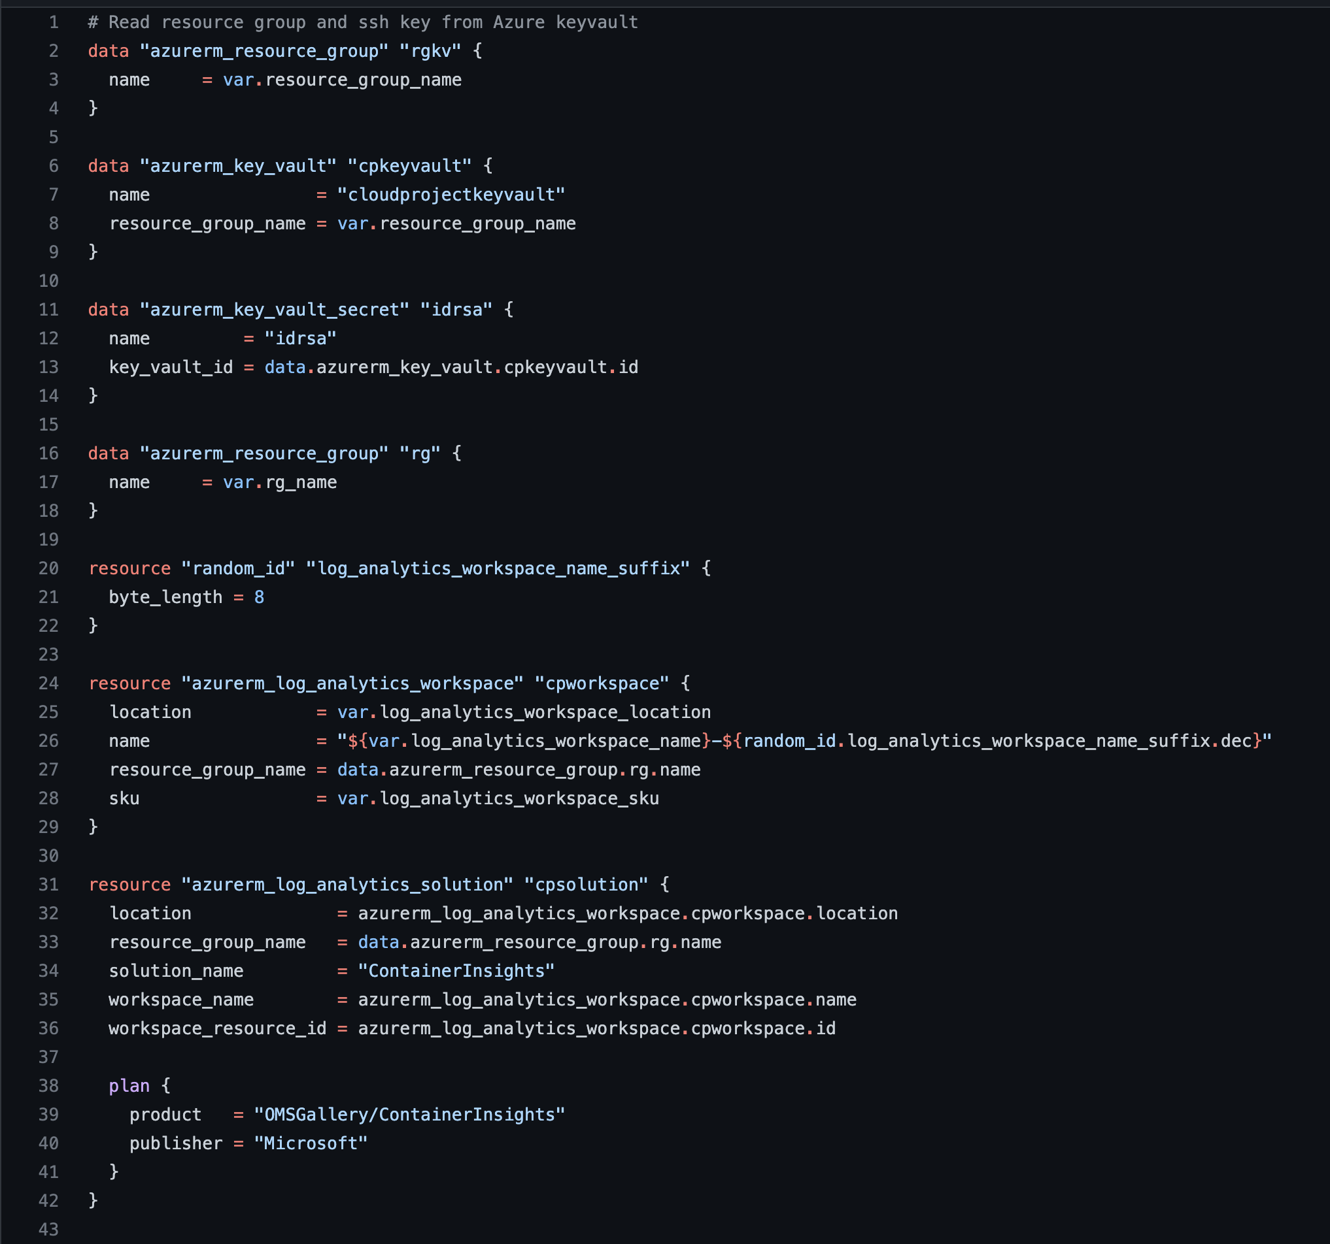
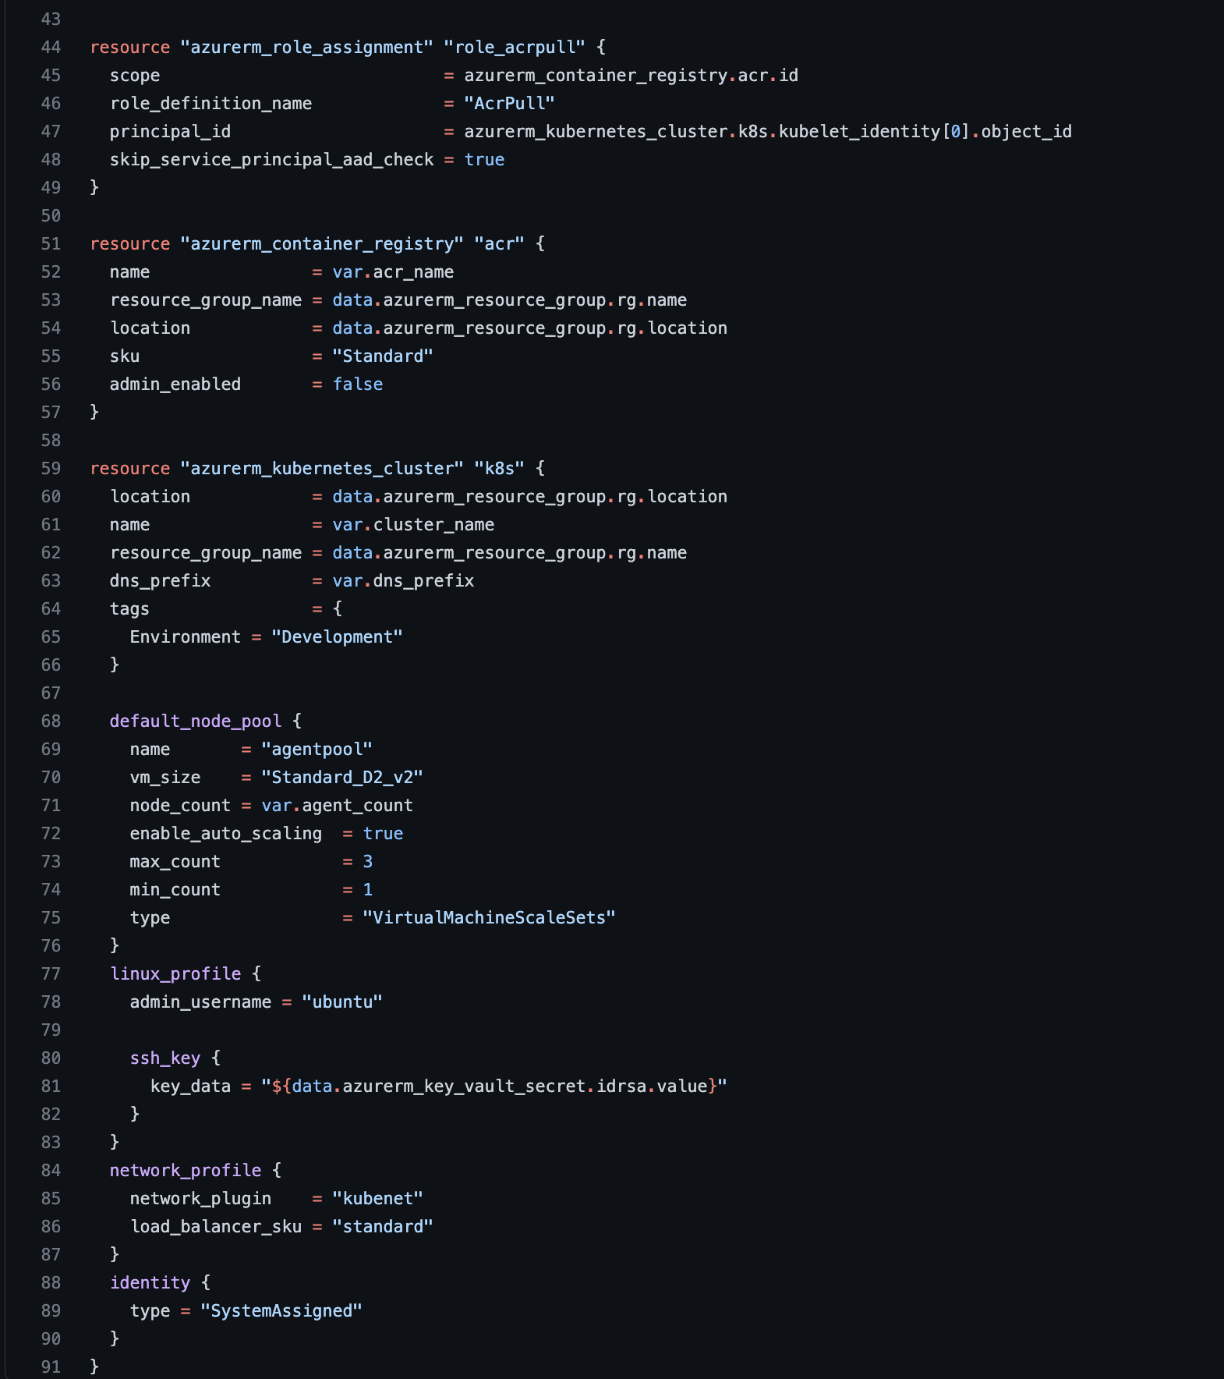
Terraform Deployment File
Repository Link: https://github.com/promiseuche/cloud-project/blob/main/Infrastructure/main.tf

Slide 12
Automation of Application Deployment

Slide 13
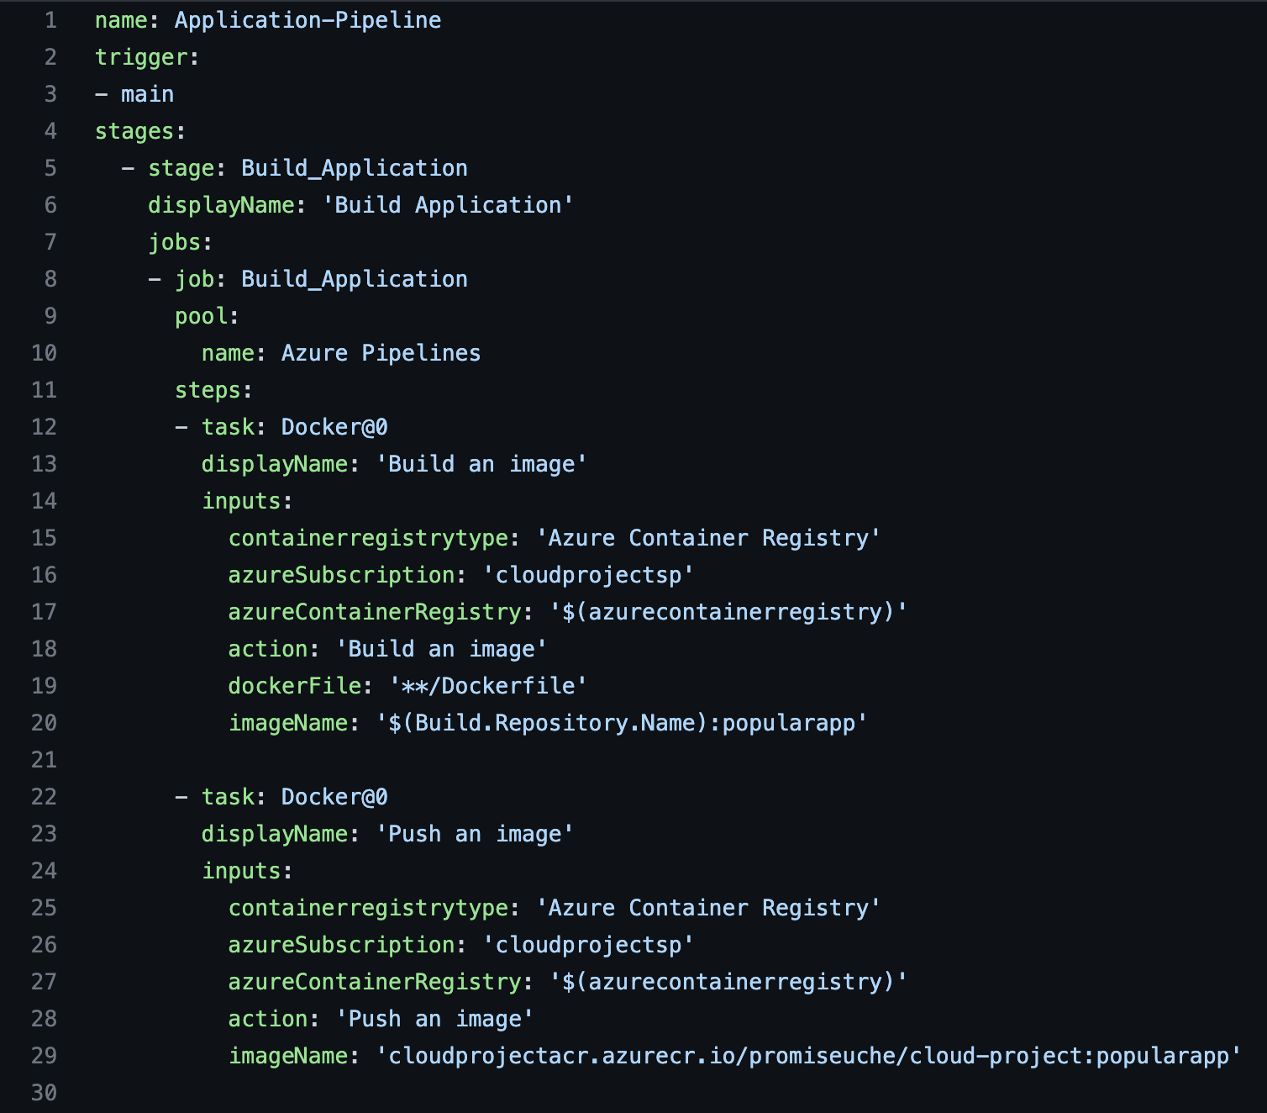
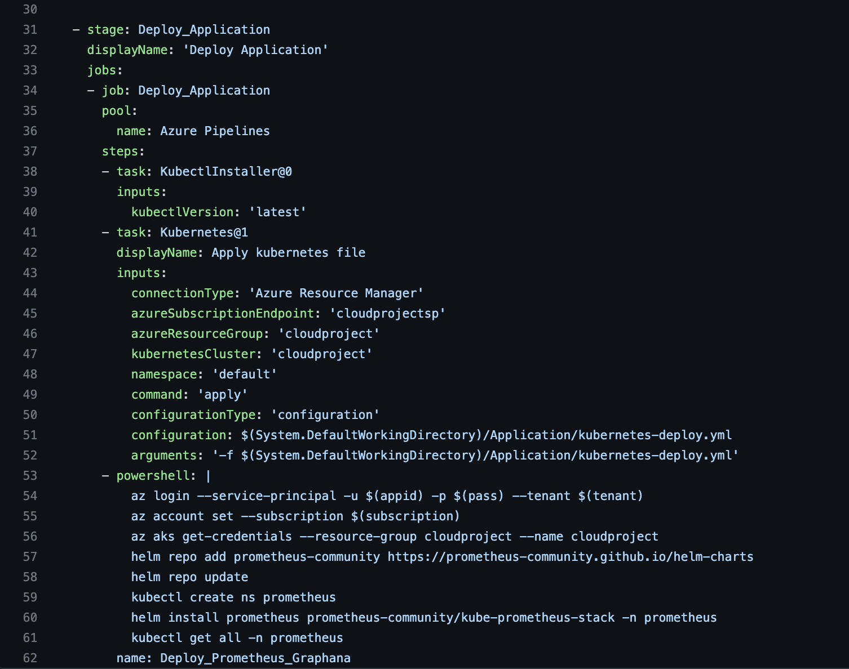
Application Pipeline Configuration File
Repository Link: https://github.com/promiseuche/cloud-project/blob/main/Application/application.yml

Slide 14
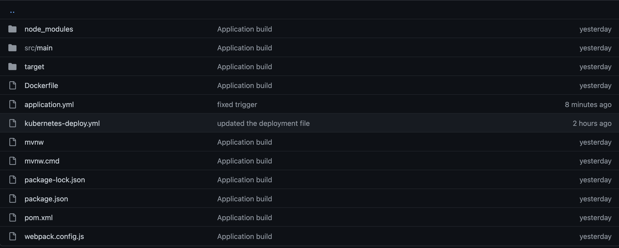
Application Deployment Directory
Repository Link: https://github.com/promiseuche/cloud-project/tree/main/Application

Slide 15
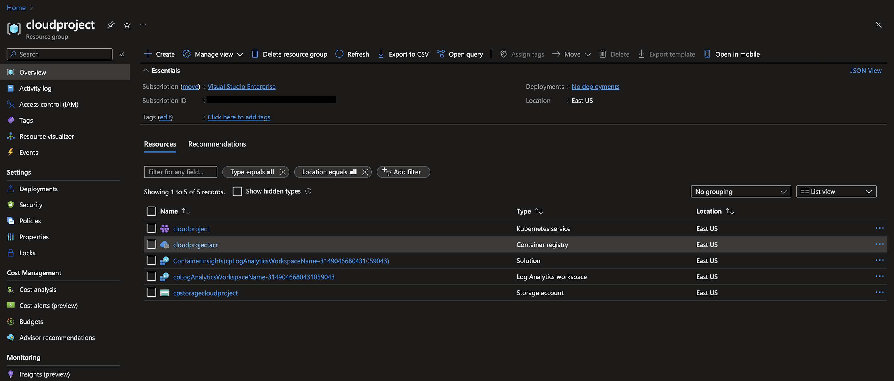
Resources Deployed

Slide 16
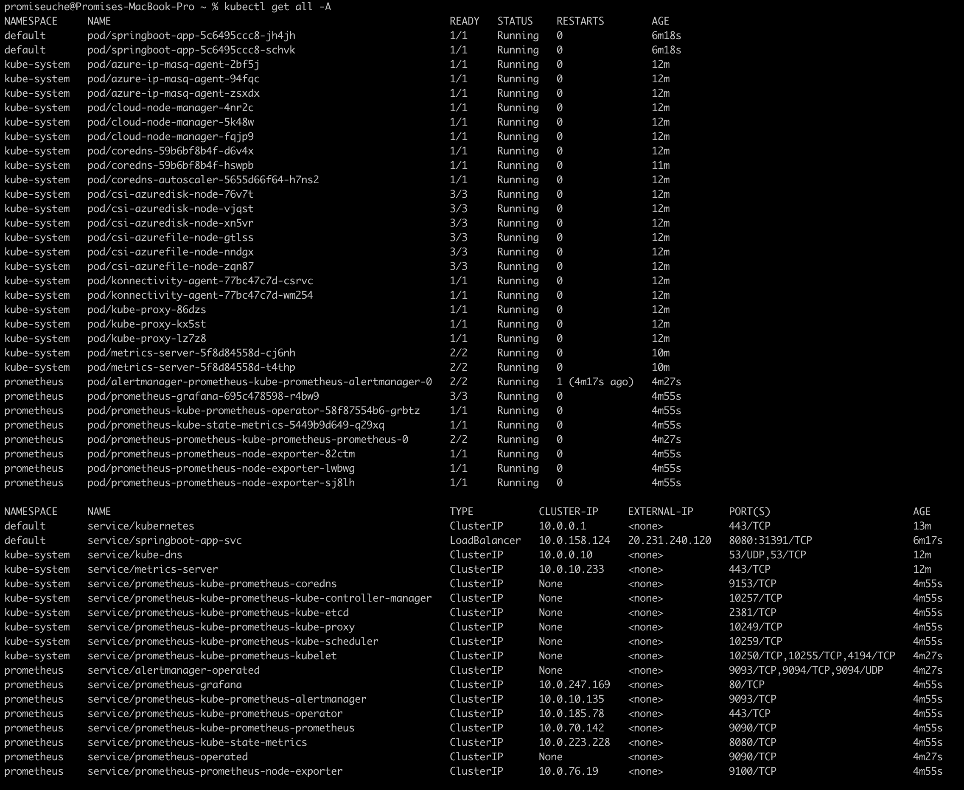
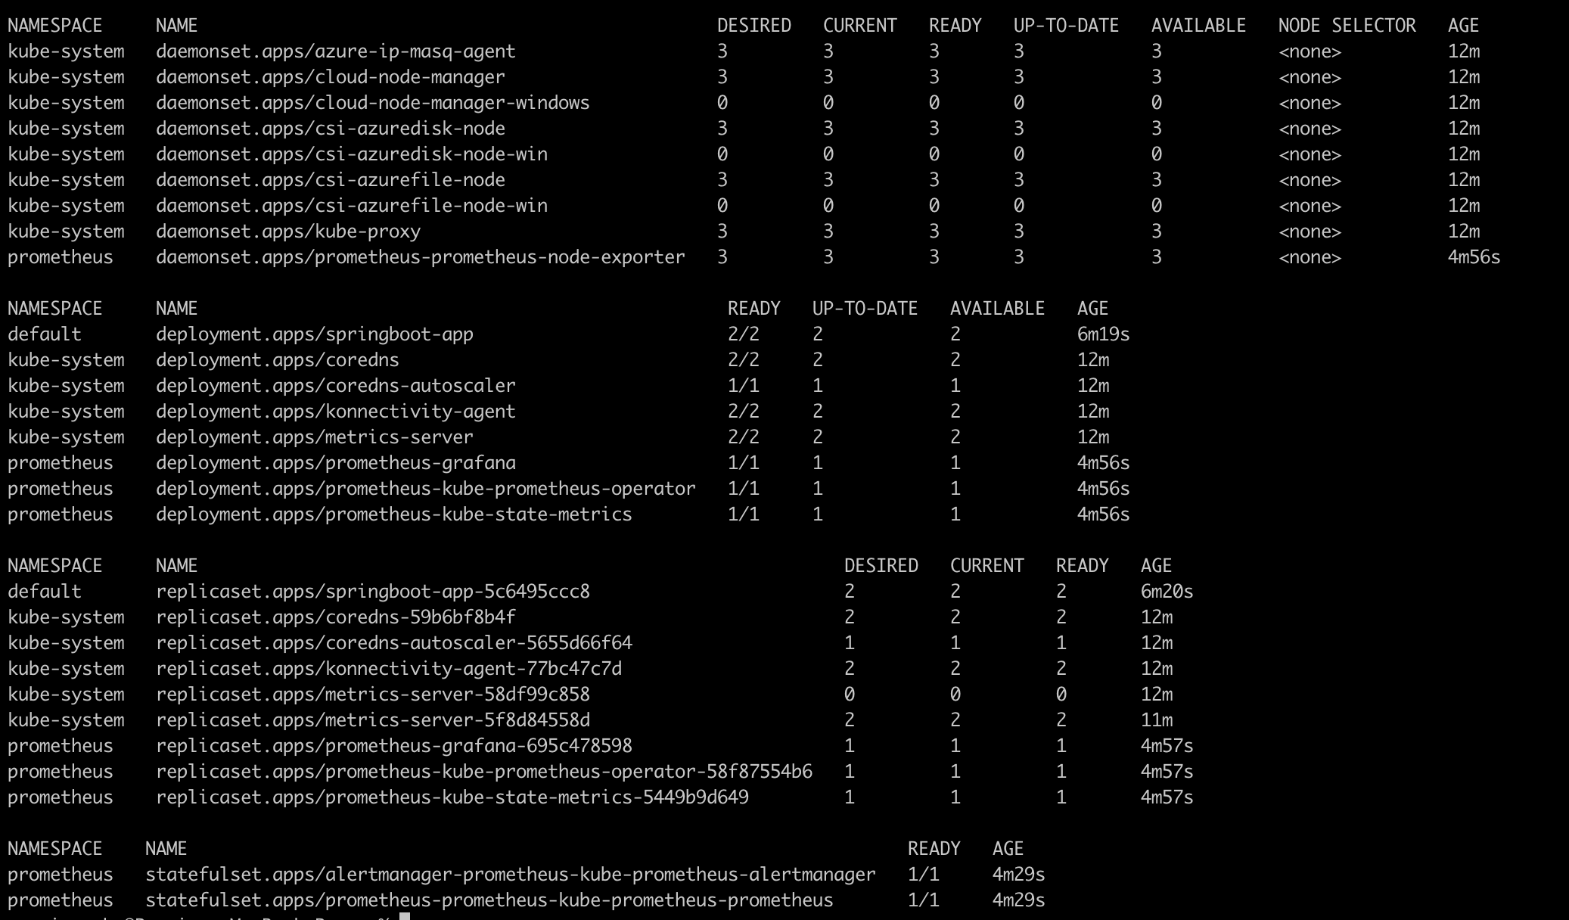
Kubernetes Resources Deployed

Slide 17
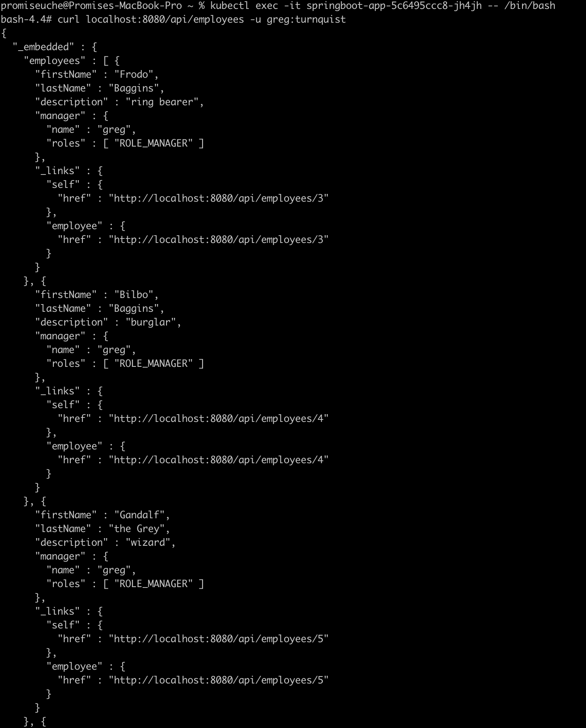
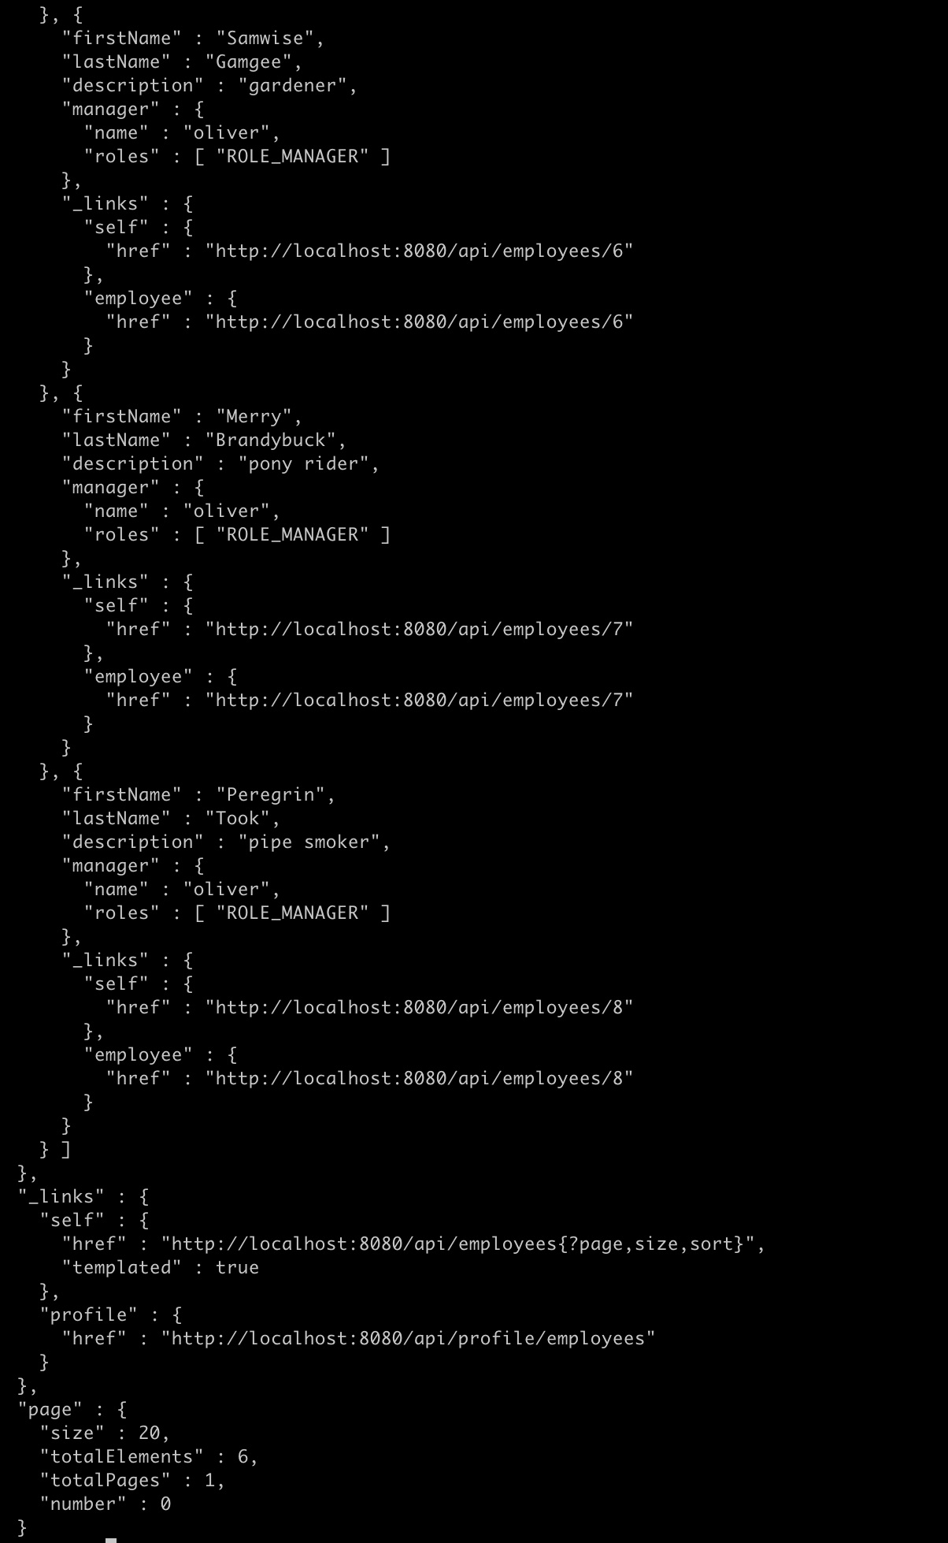
App cli Interface from the Pod

Slide 18
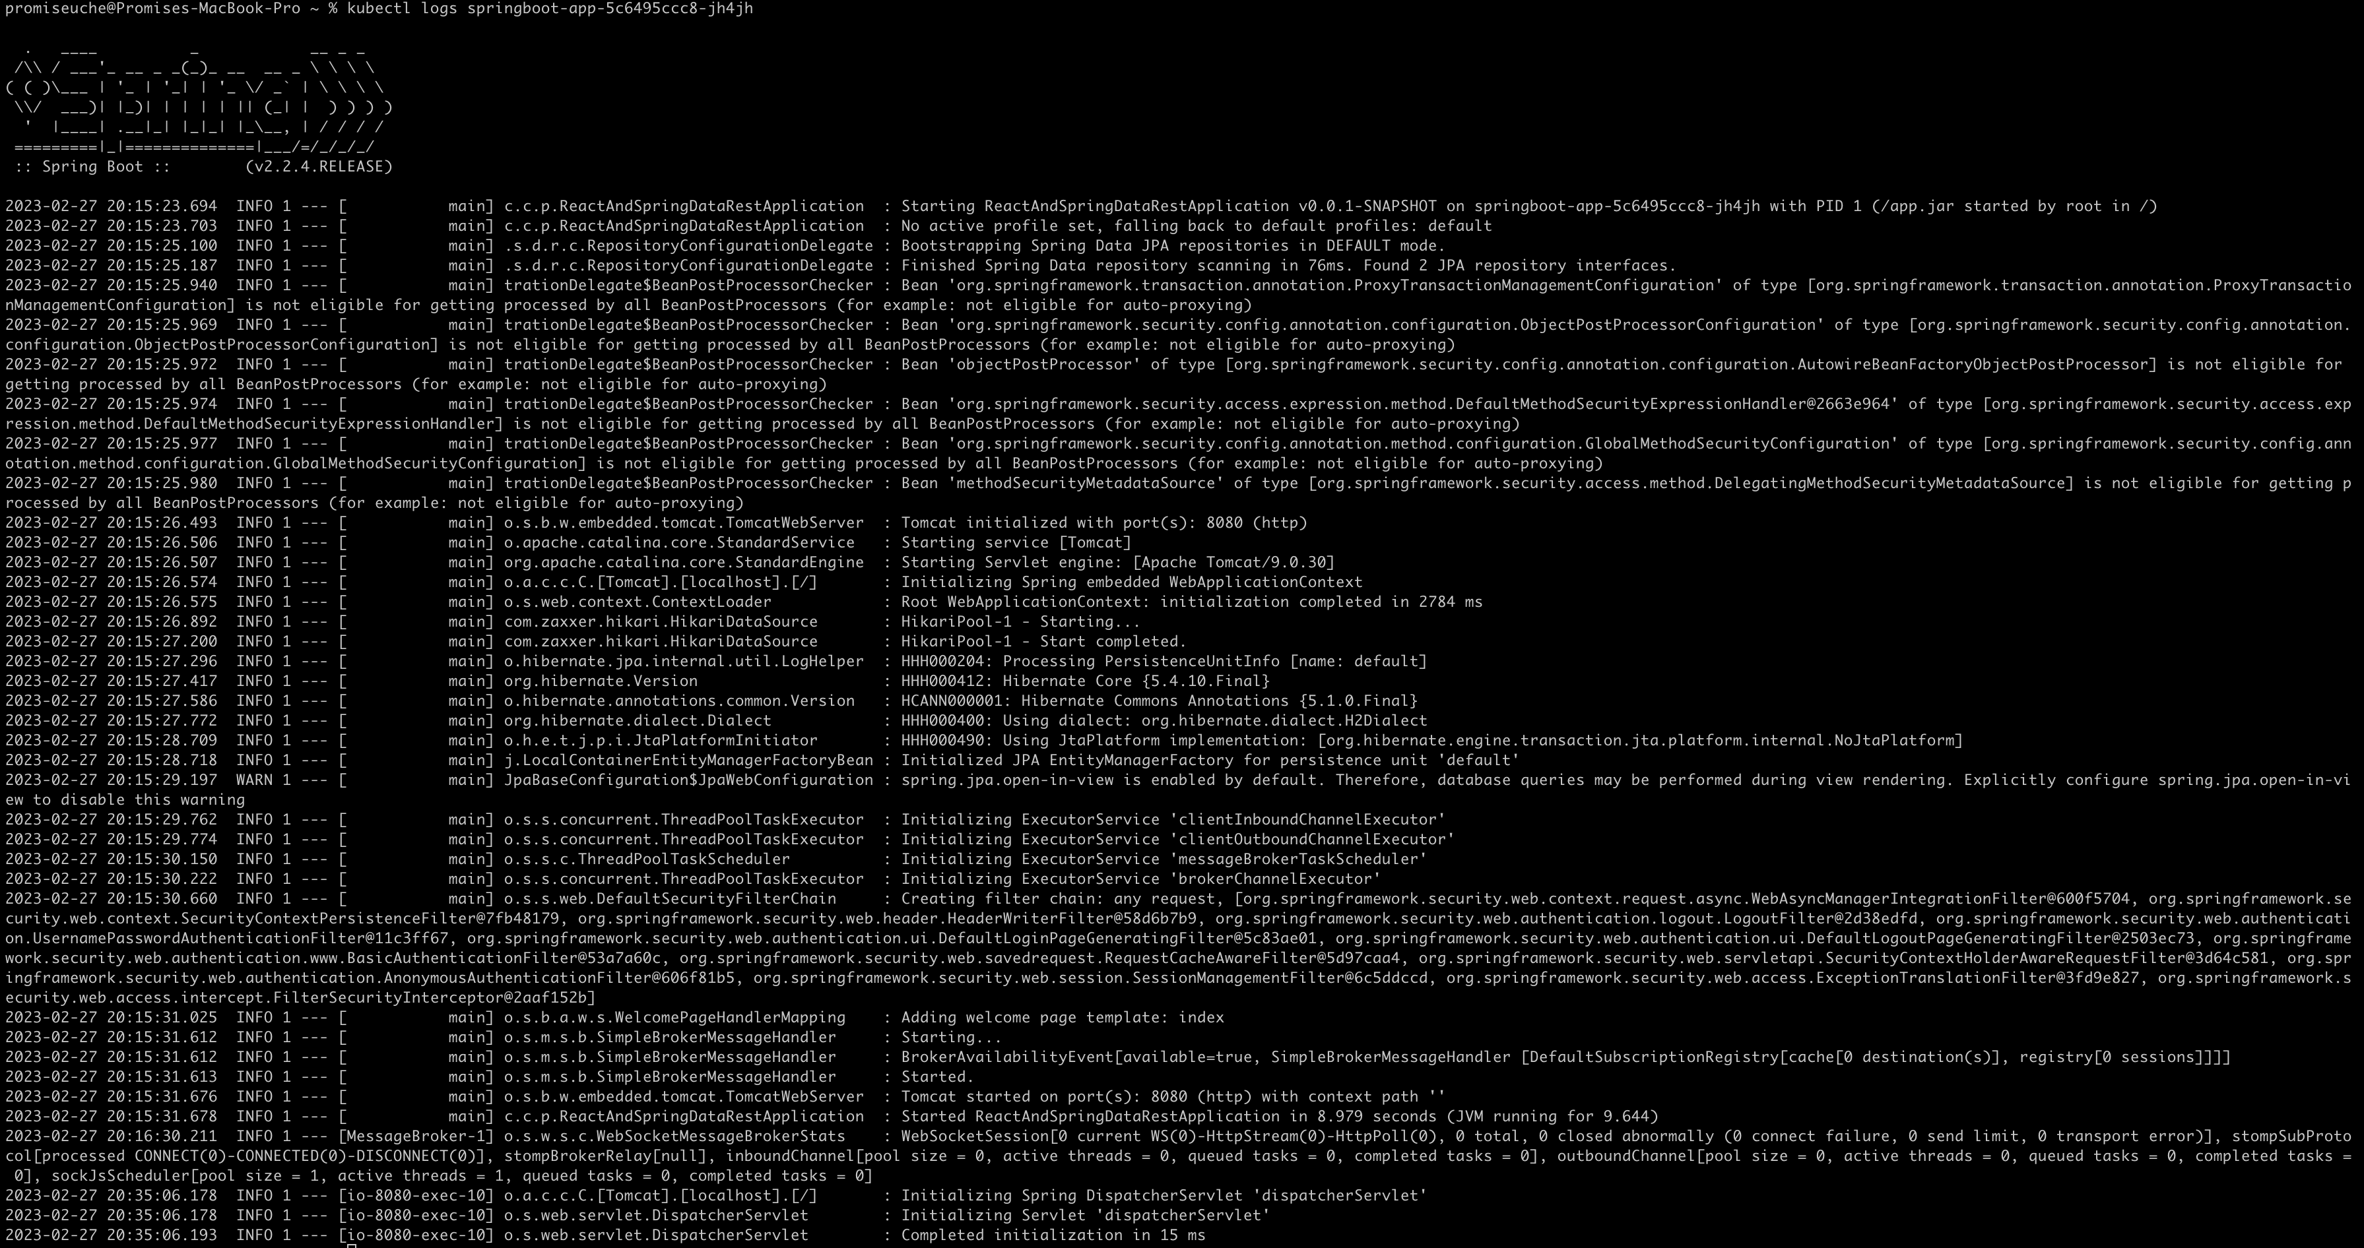
Logs from the application Pod

Slide 19
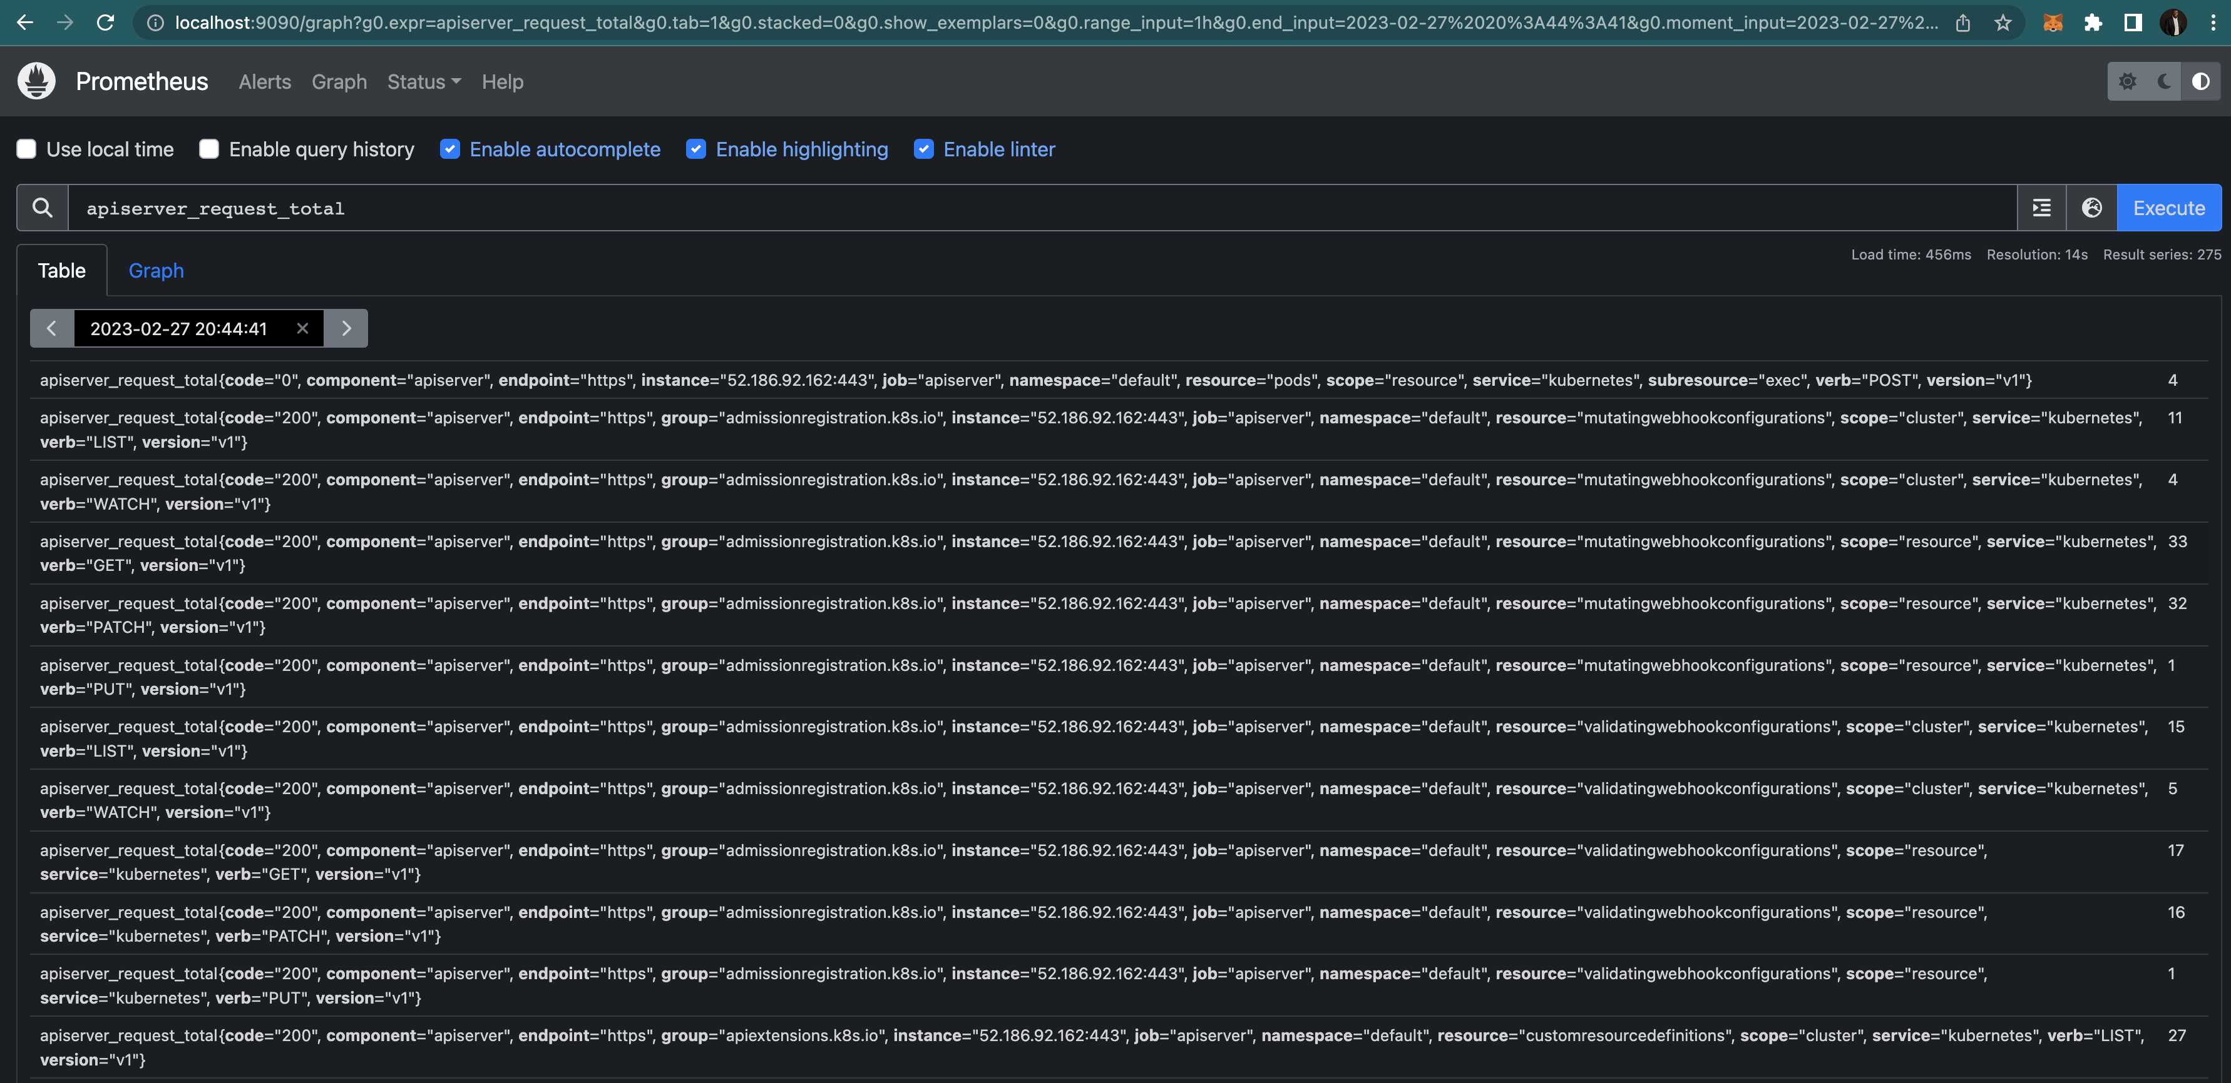
Logs from the Prometheus Pod

Slide 20
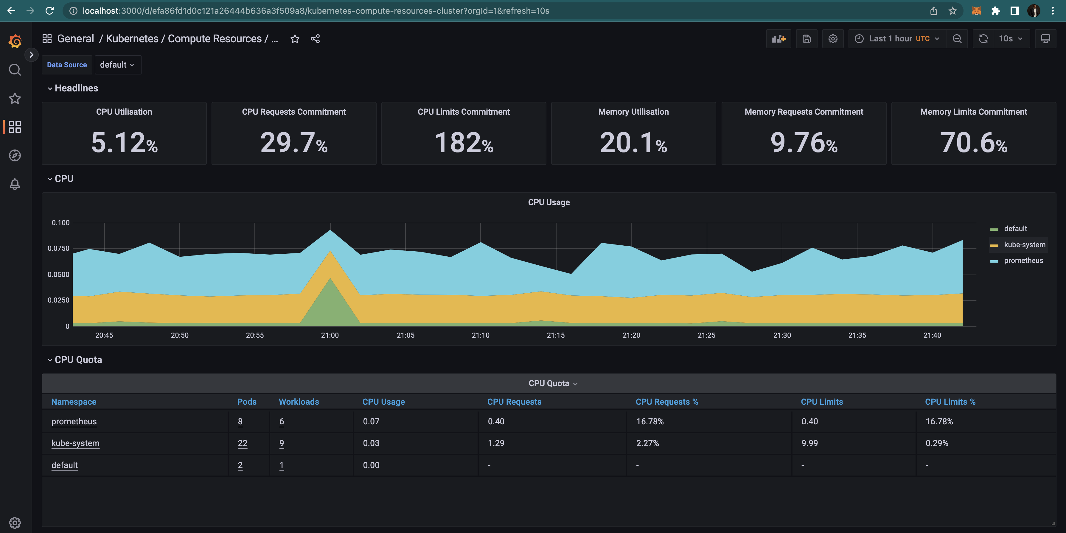
Insights from Grafana

Slide 21
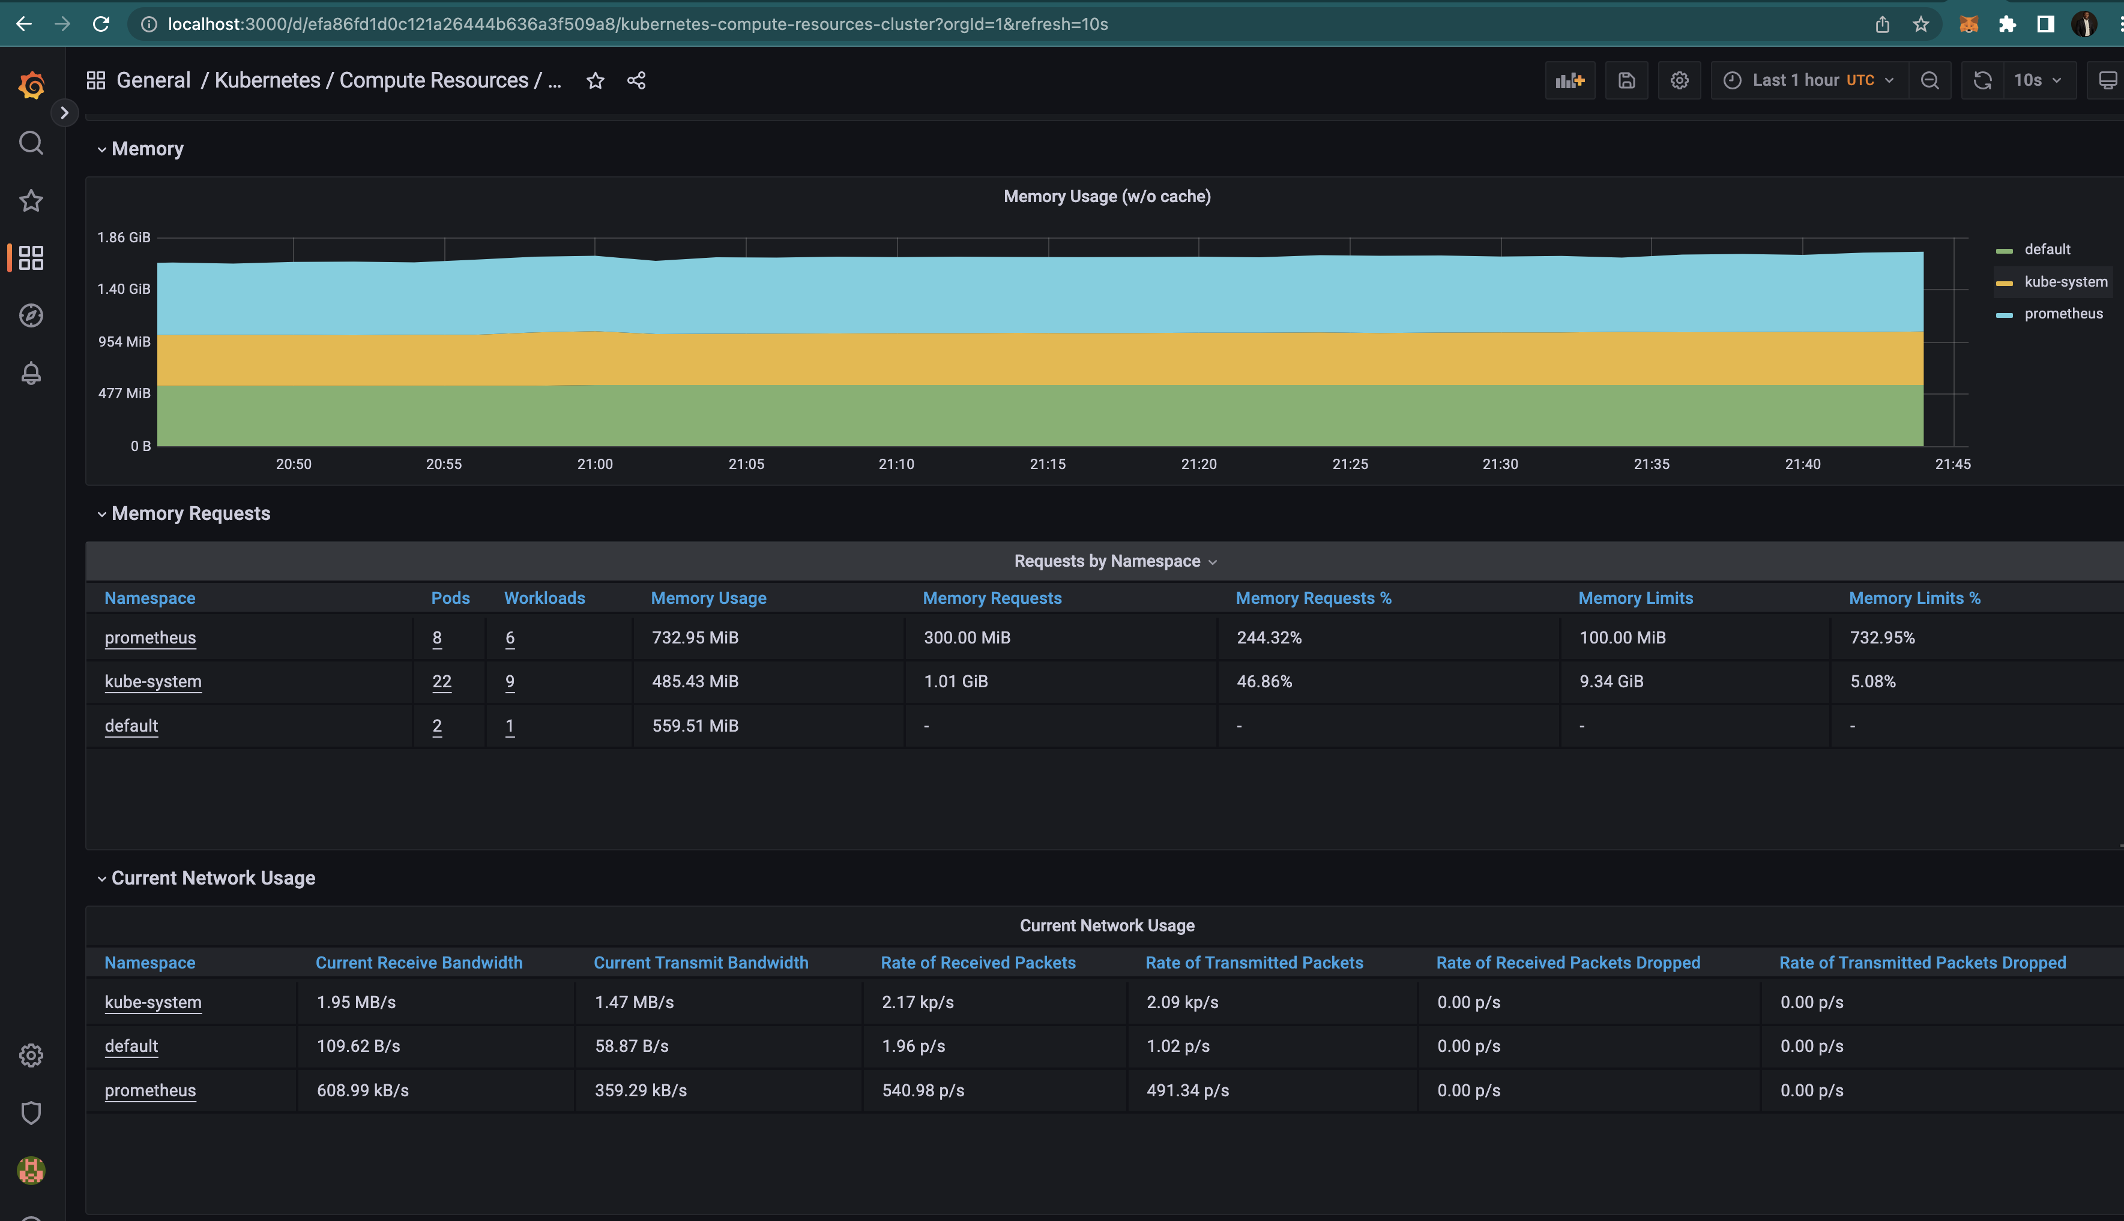
Insights from Grafana Cont’d

Slide 22
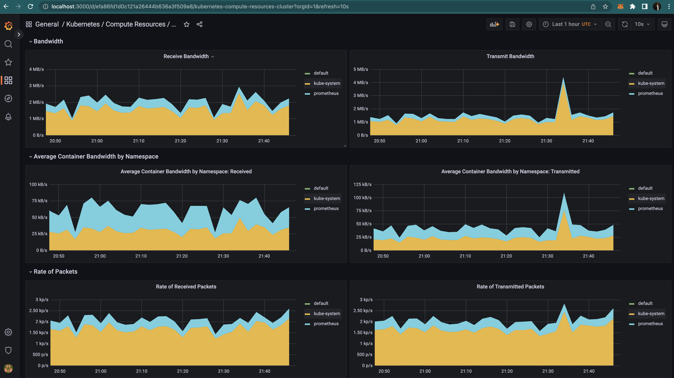
Insights from Grafana Cont’d

Slide 23
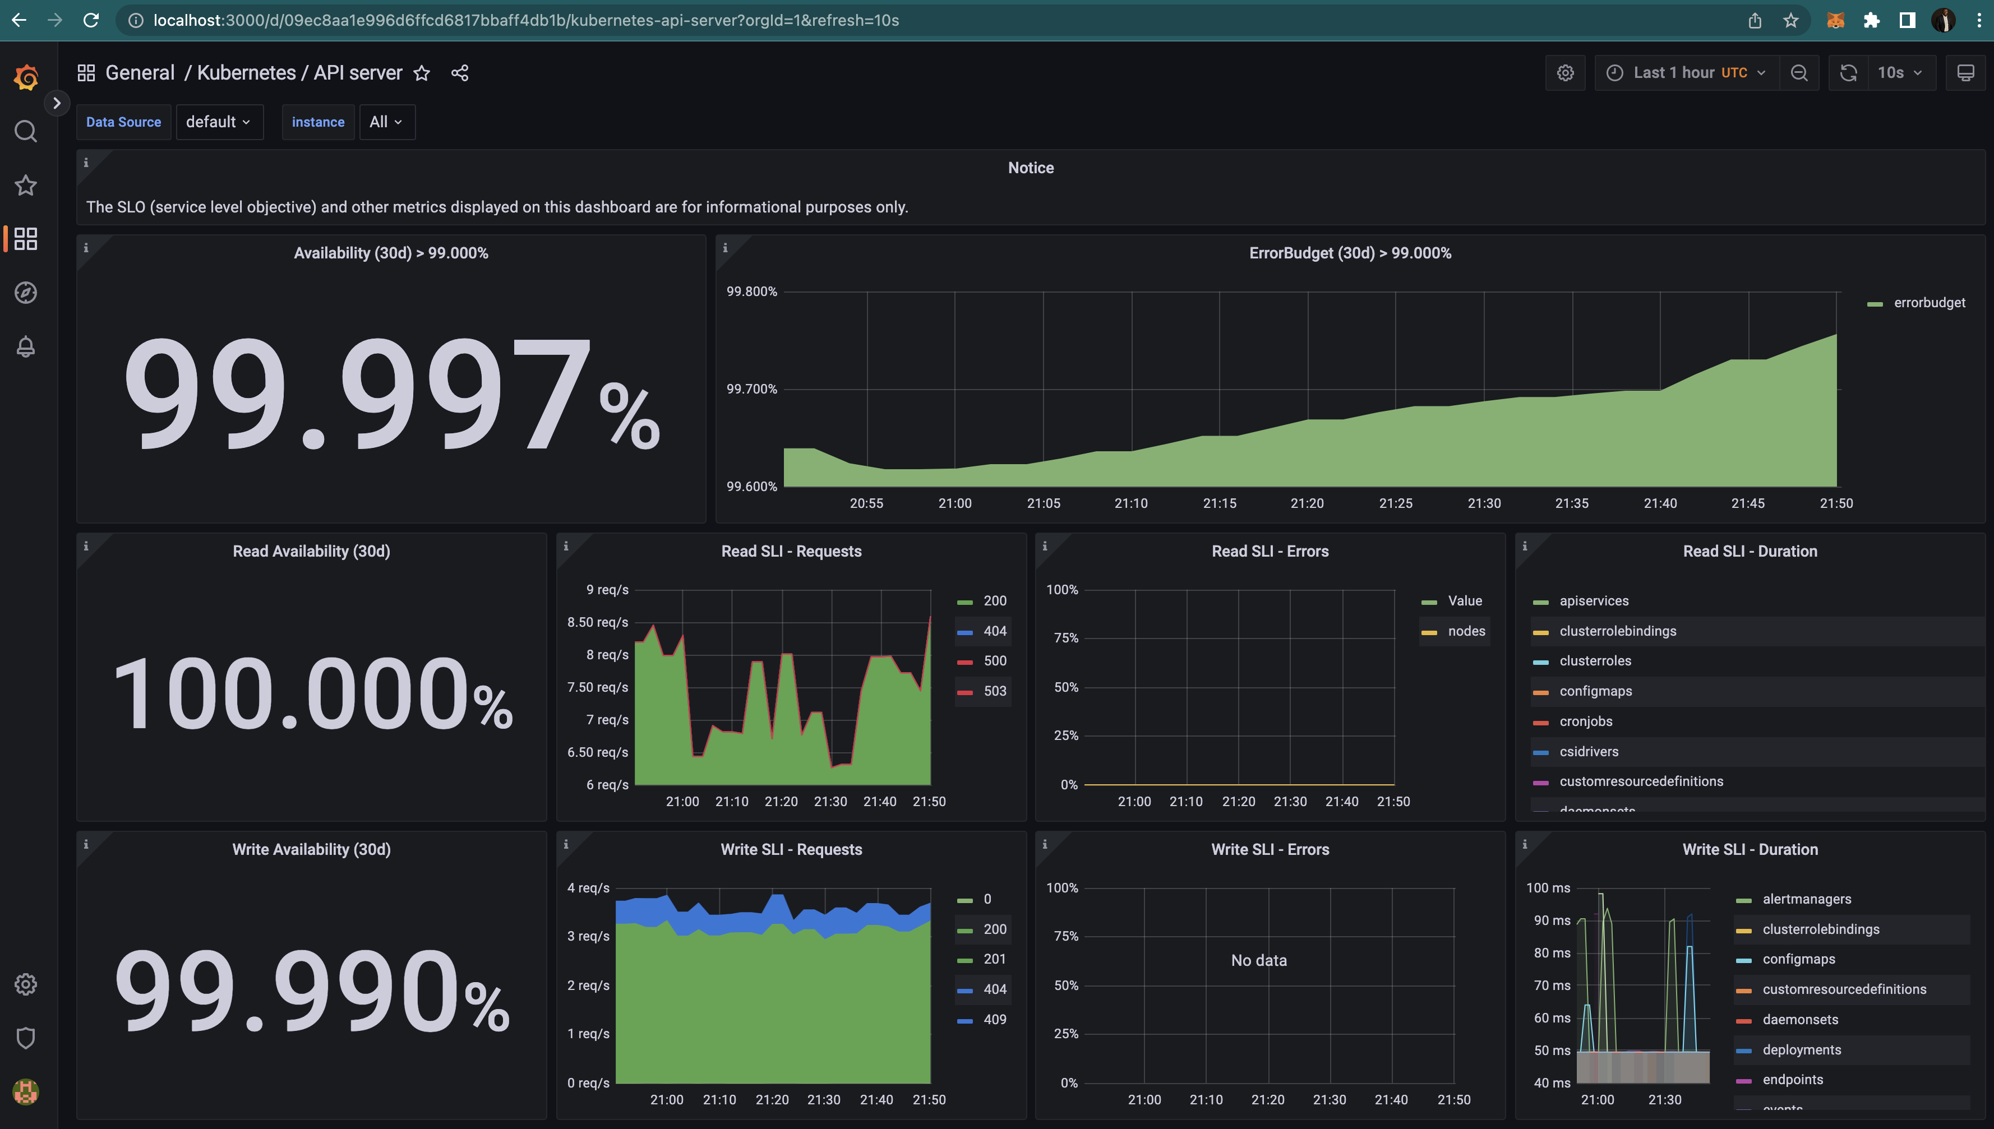
Insights from Grafana Cont’d

Slide 24
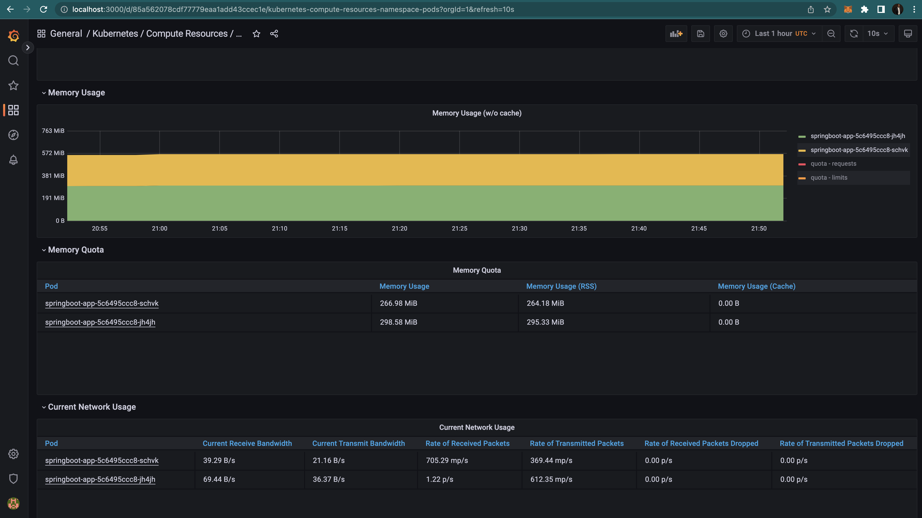
Insights from Grafana Cont’d

Slide 25
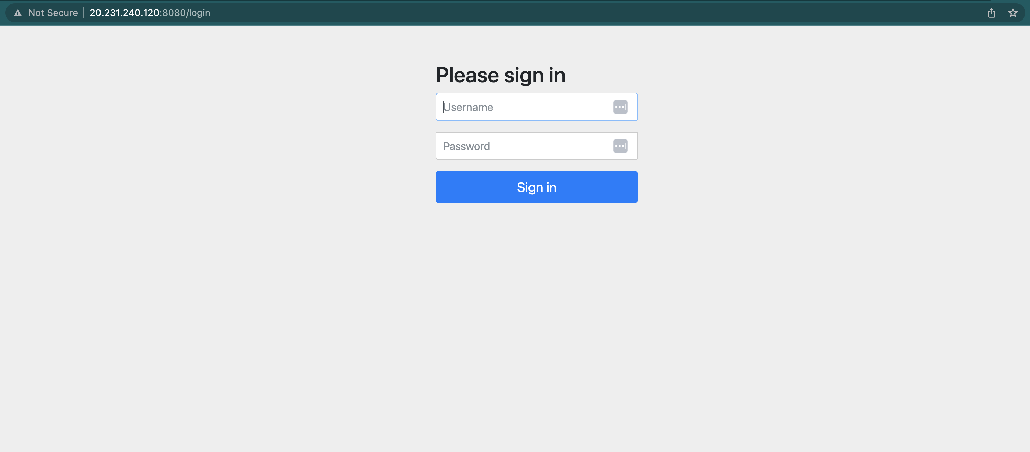
Application Interface

Slide 26
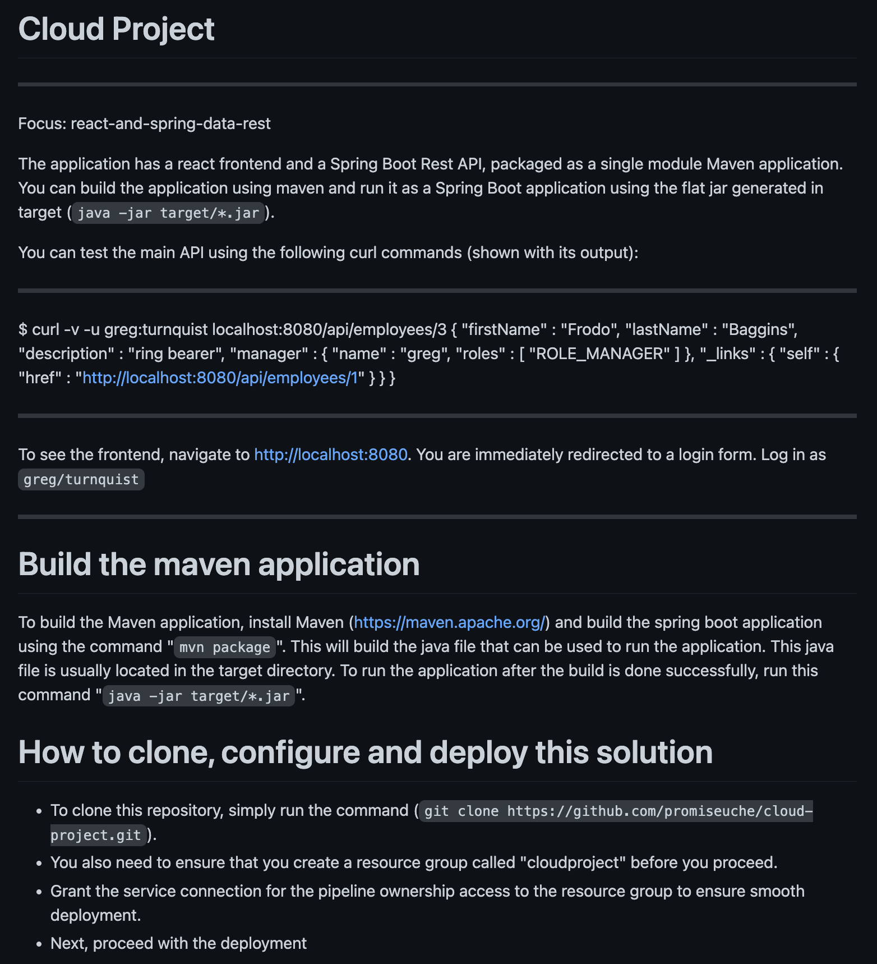
Readme File from Repository

Slide 27
Testing approach for Infrastructure

Slide 28
SonarQube
Description
Sonarqube is used to scan the code for vulnerabilities, bugs, hard coded secrets, code smells and API keys.
Sonarqube gives a description of the issue, along with the information about the type and when it was added to the code.

Slide 29
Monitoring approach for Solution

Slide 30
Monitoring the Infrastructure and Application
Description
These tools can be used for Monitoring the Infrastructure and Application:
Datadog
Service Now
Splunk
Grafana
Prometheus
Loki
komodor
In my implementation, I have made use of:
Grafana
Prometheus

Slide 31



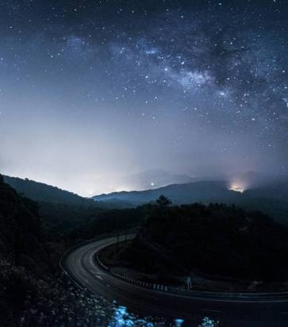
Summary
The implementation is flexible to accommodate changes or other tools as the need arises.
Source Code:
https://github.com/promiseuche/cloud-project

Slide 32


Thank you
Promise Uche Nwachukwu
Email: promiseuchenwachukwu@gmail.com
Website: http://promiseuchenwachukwu.medium.com/

